Slide 1
Windows Firewall
Team Pi

Slide 2
Windows 7 & 8.1

Slide 3
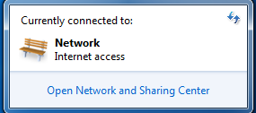
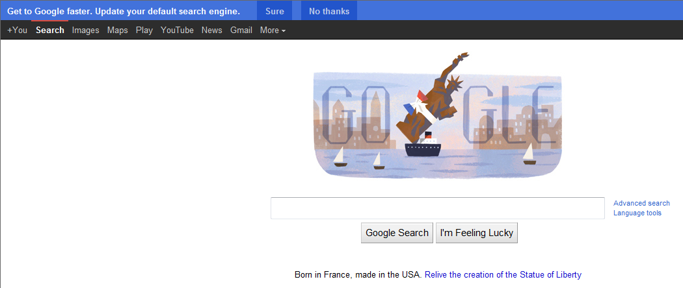
Make Sure you have Internet Connection
The first way to prove internet connection is to click the internet icon on the toolbar. This pulls up the window on the top right, which shows internet connection.
Another way to show internet access is by accessing a webpage like I did on the low right.

Slide 4
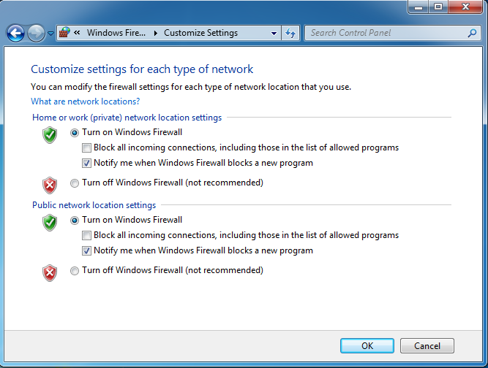
Check to make sure Windows Firewall is enabled
Windows Firewall can be accessed through the Control Panel, in the Security Section, from there choose to “turn windows firewall on or off” and the following screen will appear.
You can see that my firewall was already active.

Slide 5
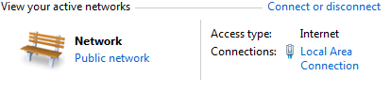
Write down the name of the network you’re currently connected to
On the right is the information for my current network, which can be found in the Network and Sharing Center.

Slide 6
Configure so that Firewall notifies when it blocks a program
As before, you can see that my Firewall was already configured to do so. However, if it isn’t then just click the checkboxes next to the option.

Slide 7
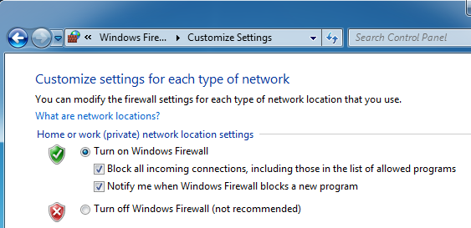
On a private network configure to block all incoming connections
The checkbox for this option is in the same place as that to notify when Firewall blocks a program.
Simply check the box to block incoming connections on private networks.

Slide 8
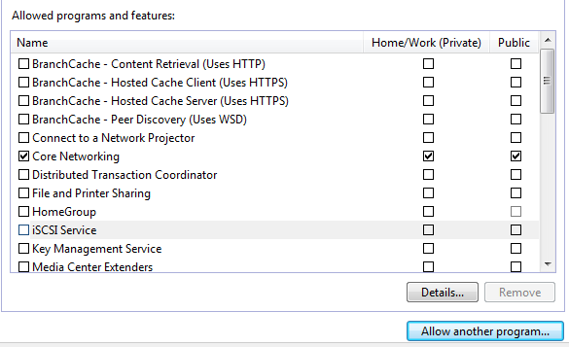
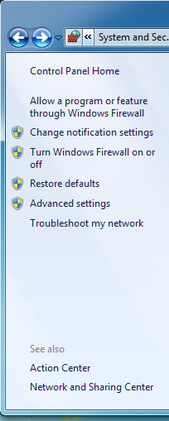
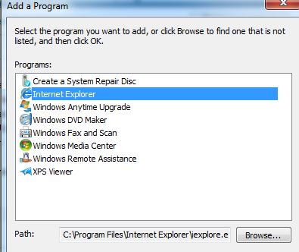
Allow Internet Explorer through the Firewall
To allow a program through the firewall click the option above that to turn the firewall on that says “Allow a program or feature through Windows Firewall” then find your program in the list to the right.
But IE isn’t here… Luckily there’s a button for allowing other programs in, click this and choose IE from the list it presents

Slide 9
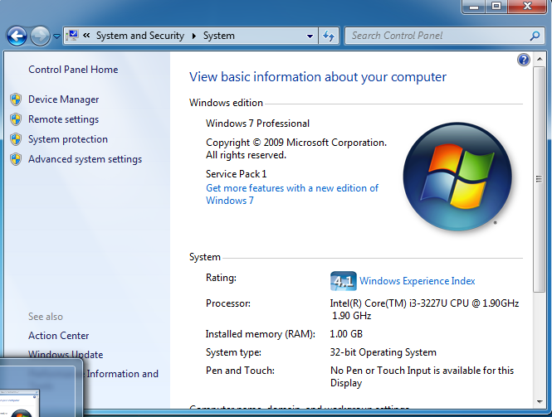
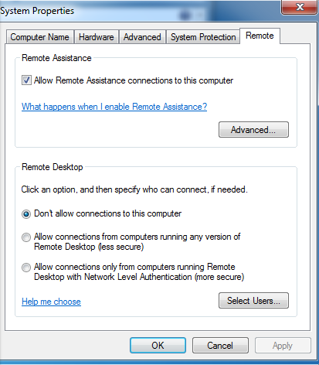
Allowing Remote Assistance
Go to the system menu, which can be found in the control panel. After this find the option on the left for Remote Settings. Afterwards pick who you want to allow to assist you. The 3rd option is the most secure, so go with that if people helping you use Windows 7.
After this, go back and allow Remote Assistance like we did IE. But check the box for Private and not for Public.

Slide 10
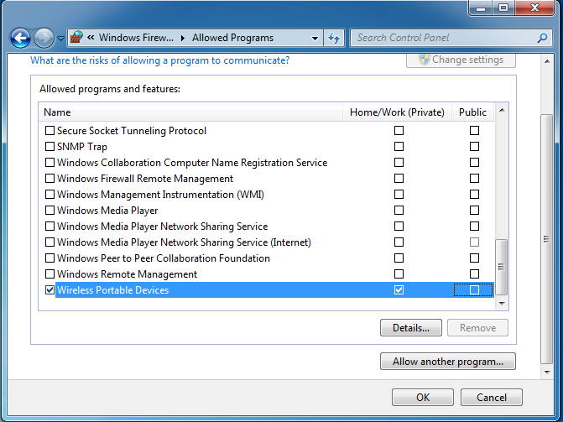
Allow Wireless Portable Devices
The next two slides both allow one program through Windows Firewall the same way we did with Internet Explorer, except without the need to browse for it, as they are in the initial menu.

Slide 11
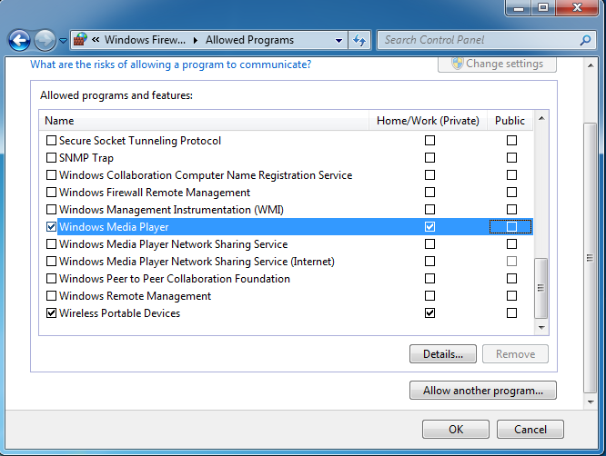
Allowing Windows Media Player
This slide shows the location of Windows Media Player, above the Wireless Devices option we just enabled.

Slide 12
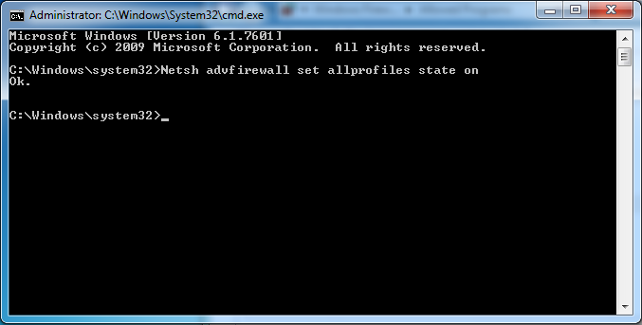
Turn on Windows Firewall for all users
While you could go through the process of accessing every account and turning on the firewall like in step two, there is a fast way.
Open a command prompt and run it as administrator. Type in,
Netsh advfirewall set allprofiles state on
This turns on Windows Firewall for all profiles, and responds “Ok” if it works.

Slide 13
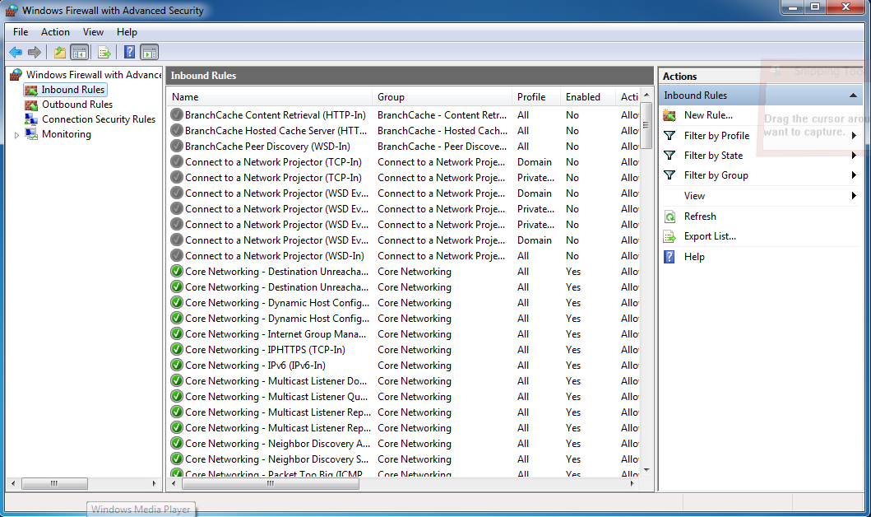
Allow outgoing connections, but deny incoming connections
To do this we’ll have to create a rule in the advanced section of Windows Firewall settings. Find the advanced section in the same area as allowing programs through.
Choose Inbound Rules and click New Rule to get started.

Slide 14
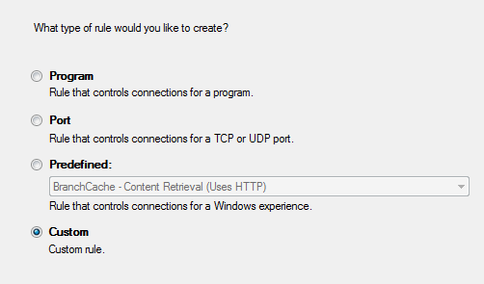
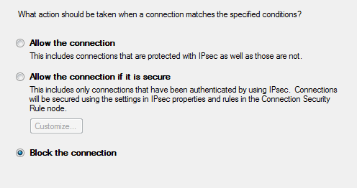
Allow outgoing connections but deny incoming connections
When asked what type of rule to make, choose a custom rule. Next a series of questions will come about when your rule applies. Answer all of these with the option that describes all situations.
Finally, choose the option to Block the Connection.

Slide 15
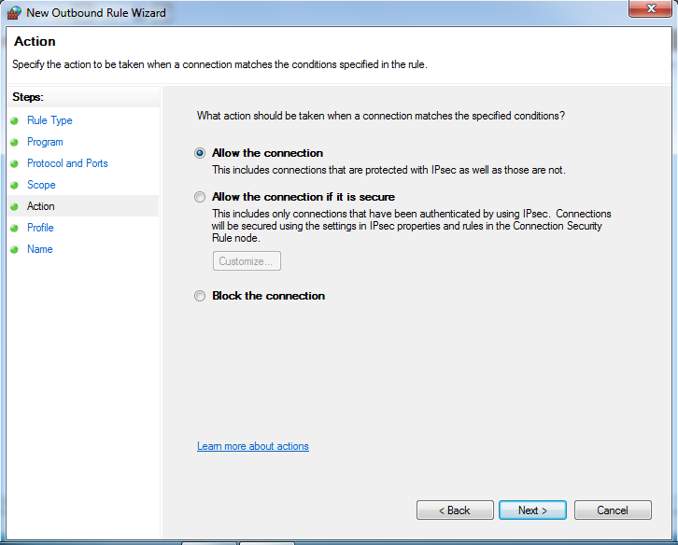
Allow outgoing connections but deny incoming connections
Next do the opposite. With an outbound rule, make a custom rule that allows all connections.
Here are some shots to show what this process looks like.

Slide 16
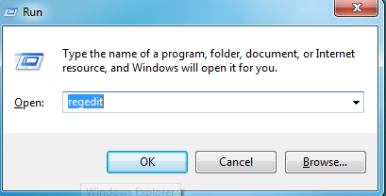
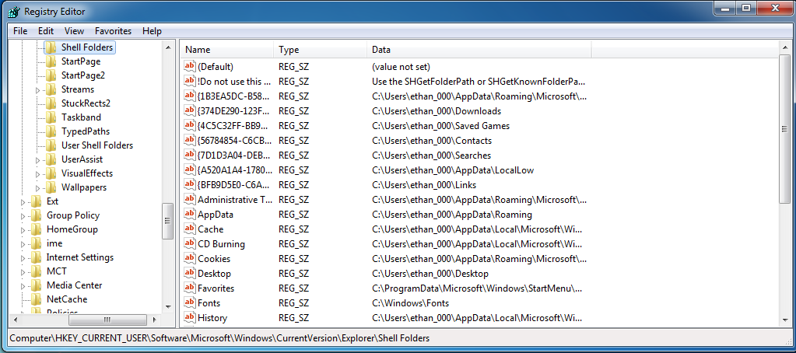
Save the Log Files in C:\Users\<your admin account name folder> for all profiles
For this we go back to the registry once more. Open the start menu and click run, from there type in regedit and press enter to open the registry editor.

Slide 17
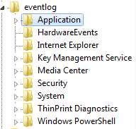
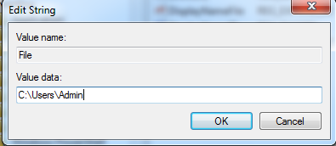
Save the Log Files in C:\Users\<your admin account name folder> for all profiles
Navigate to the key
HKEY_LOCAL_MACHINE\SYSTEM\CurrentControlSet\Services\Eventlog
Within that key are subkeys that match the files found within the logs. Edit the file subkey of each of these keys and replace the Value box with the full pathname where you want to relocate them.

Slide 18
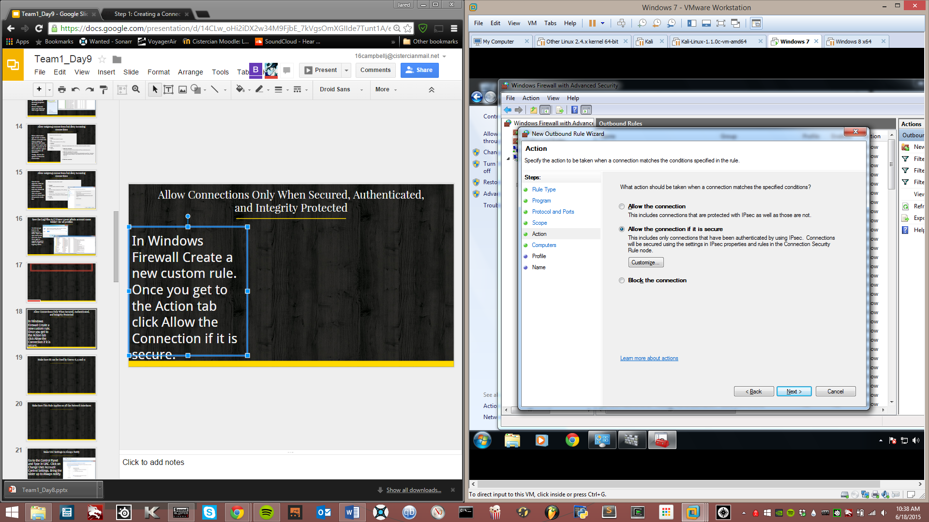

Allow Connections Only When Secured, Authenticated, and Integrity Protected
In Windows Firewall Create a new custom rule. Once you get to the Action tab click Allow the Connection if it is secure. Under Customise we see the option for Secured and Integrity Protected.

Slide 19
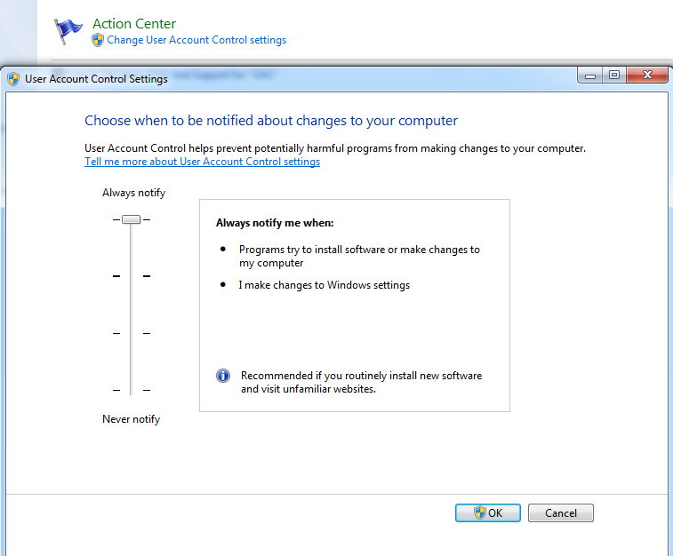
Make UAC Settings to Always Notify
Go to the Control Panel and Type in UAC. Click on Change User Account Control Settings. Bring the slider up to Always notify.

Slide 20
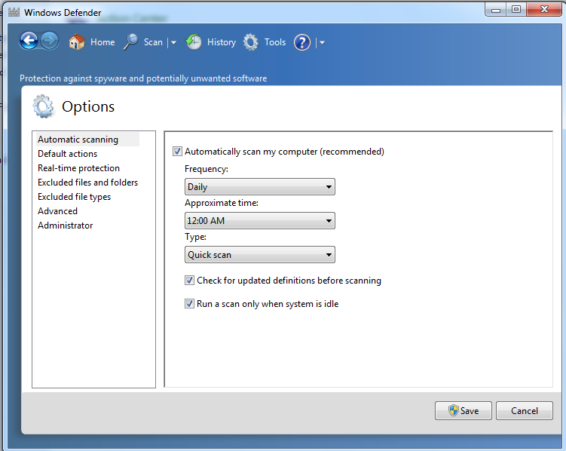
Make Sure Windows Defender Performs Quick Scan Everyday at 12 AM
Navigate to Tools>Options>Automatic Scanning.

Slide 21
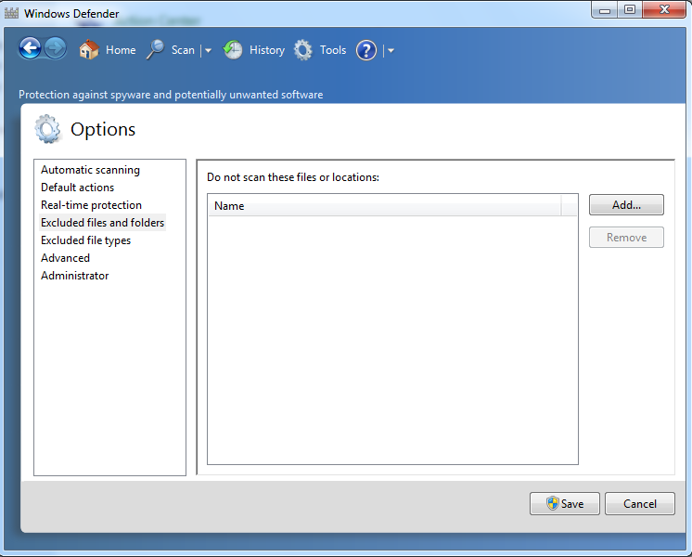
Exclude the Home Folders When Quick Scan is Performed
Navigate to Tools>Options>Excluded Files and Folders. Click add and navigate to the home folders you want to exclude.

Slide 22
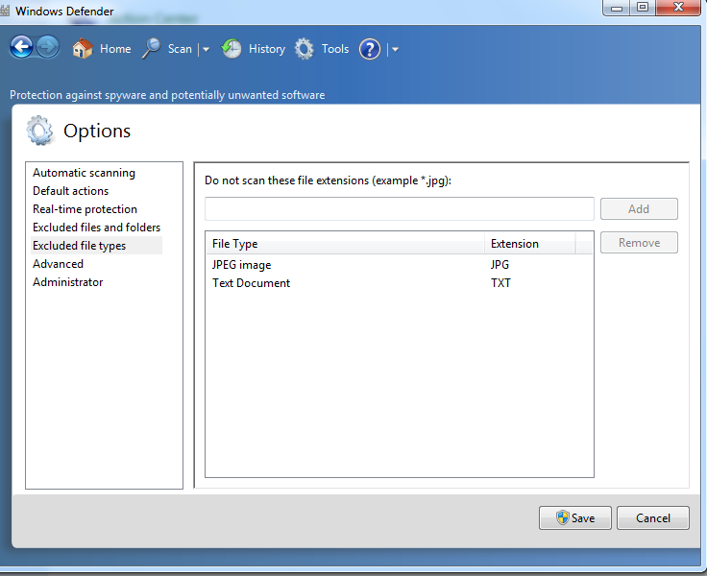
Do Not Scan .txt and .jpg files
Navigate to Tools>Options>Exclude File Types and type in TXT and JPG then click add.

Slide 23
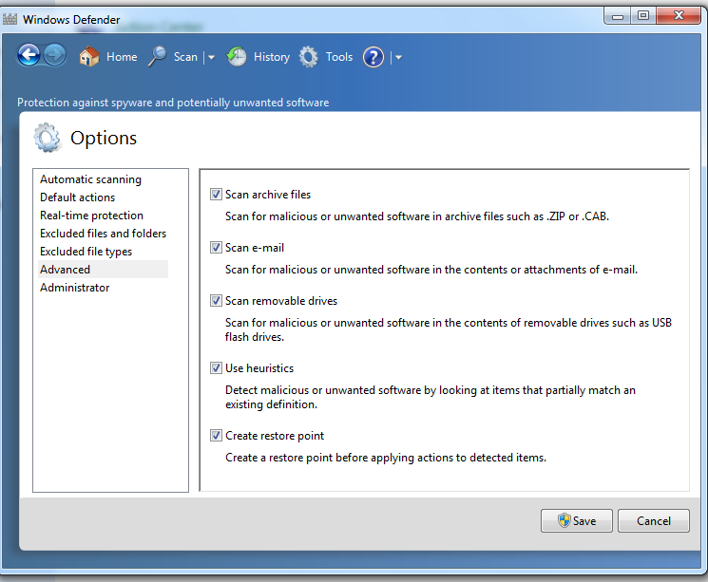
Use Windows Defender to Scan Emails and Removable Drives
Navigate to Tools>Options>Advanced.

Slide 24
Windows Server 2008

Slide 25
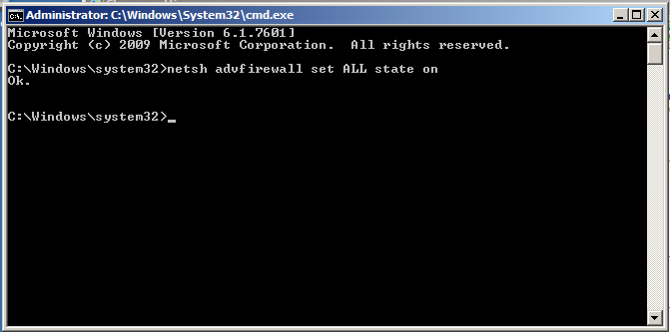
Turn On Firewall
Simple netsh command to turn the firewall on.
>netsh advfirewall set ALL state on

Slide 26
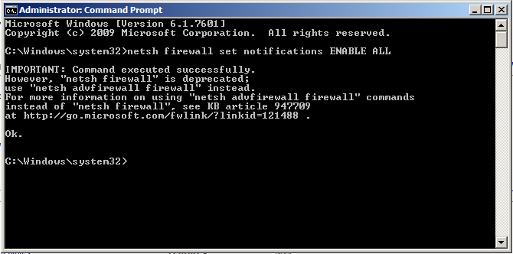
Notify All Profiles When Blocking a Program
Another simple netsh command.
>netsh firewall set notifications ENABLE ALL

Slide 27
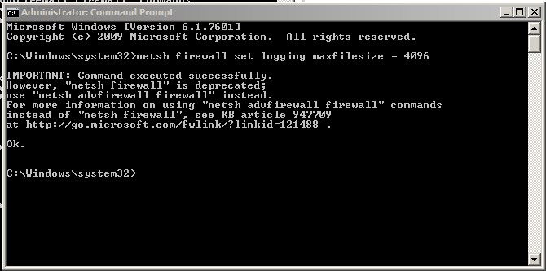
Increase Log File Size
Again, simple command to set log file size to 4096.
>netsh firewall set logging maxfilesize = 4096

Slide 28
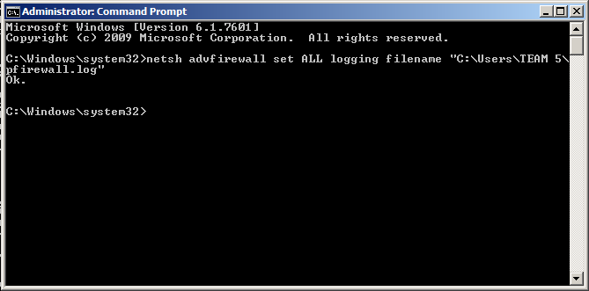
Save Log File in Admin Directory
Created new file and specified the path with command.
>netsh advfirewall set ALL logging filename
“C:\Users\TEAM 5\pfirewall.log”

Slide 29
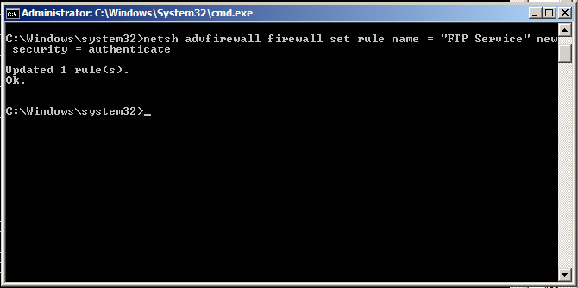
Only Allow Secure FTP Connections
This is how you do it in command line.
>netsh advfirewall firewall set rule name = “FTP Service”
new security = authenticate

Slide 30
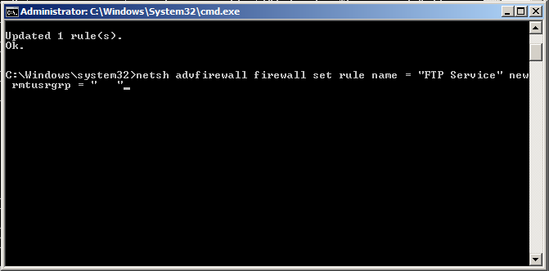
Allow TCP Connections Only From Users 1-10
First assign all the users to a group, set rule to allow the user group. The group would go in the space.
>netsh advfirewall firewall set rule name = “FTP Service”
new rmtusrgrp = “<grouphere>”

Slide 31

Apply TCP Rule to All Network Interfaces
This is how you do it in command line.
>netsh advfirewall firewall set rule name = “FTP Service”
new interfacetype = any

Slide 32
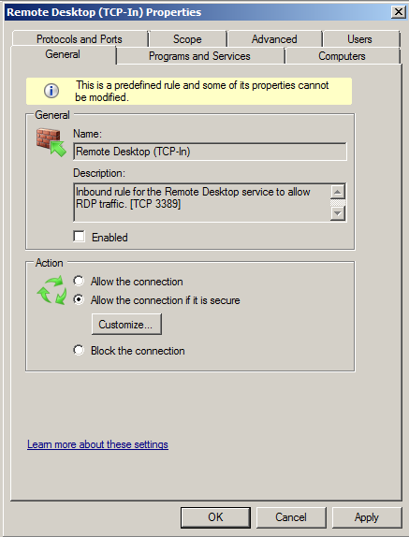
Only Allow Secure RDP Connections
In the Advanced Firewall GUI open the RDP Service Rule properties and click ‘Allow the connection if it is secure’

Slide 33
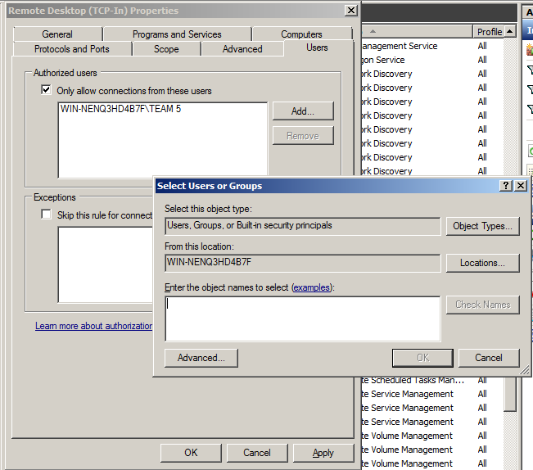
Allow RDP Connections Only From Users 1-10
In the RDP rule property under the ‘Users’ tab check ‘Only allow…’ and then click ‘Add’ and specify the users.

Slide 34
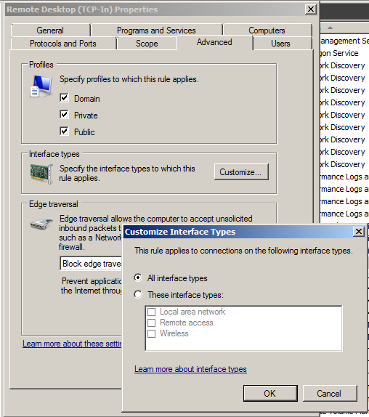
Apply RDP Rule to All Network Interfaces
In the RDP rule properties in the ‘Advanced’ tab, click the ‘Customize’ button in the ‘Interface types’ section. Click ‘All interface types’.

Slide 35
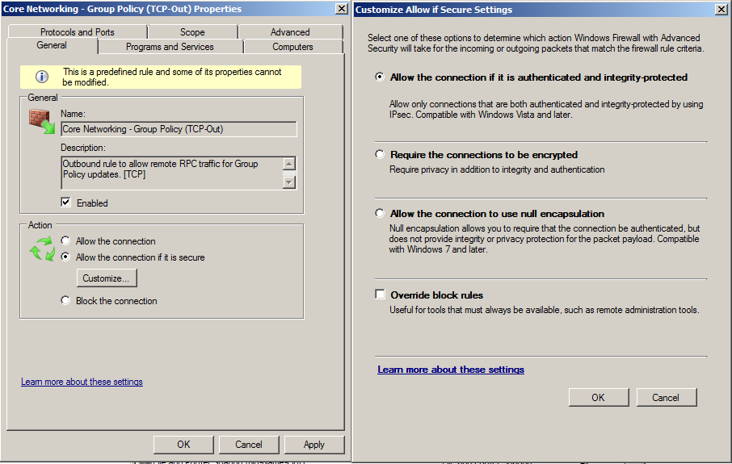
Require Encryption On Outbound TCP UDP Connections
In the out rules for both UDP and TCP, under the ‘General’ tab click ‘Customize’ and then ‘Require the...’

Slide 36
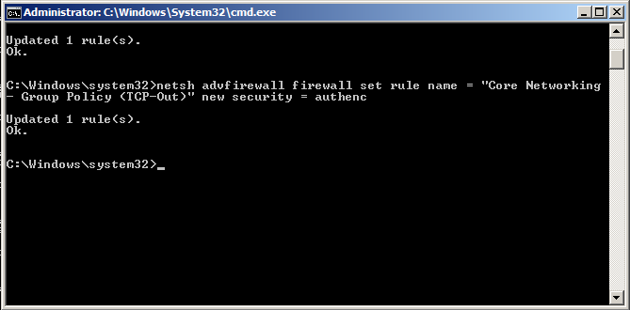
Require Encryption On Outbound TCP UDP Connections
This command sets the TCP outbound rule to require encryption. Replace the ‘TCP’ with ‘UDP’ to set the UDP rule.
>netsh advfirewall firewall set rule name = “Core
Networking - Group Policy (TCP-Out)” new security =
authenc

Slide 37
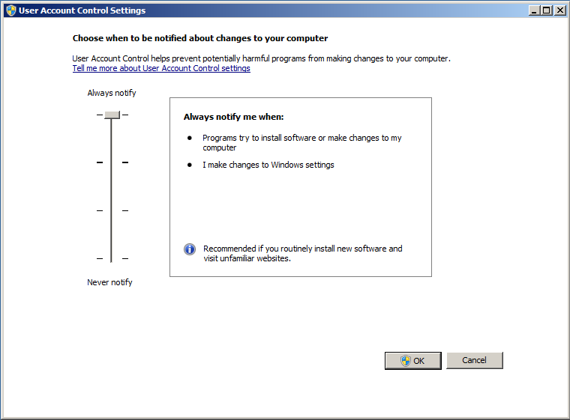
Change UAC Setting to Always Notify
Open the start menu and type ‘uac’ and press enter. Drag the slider to the top.

Slide 38
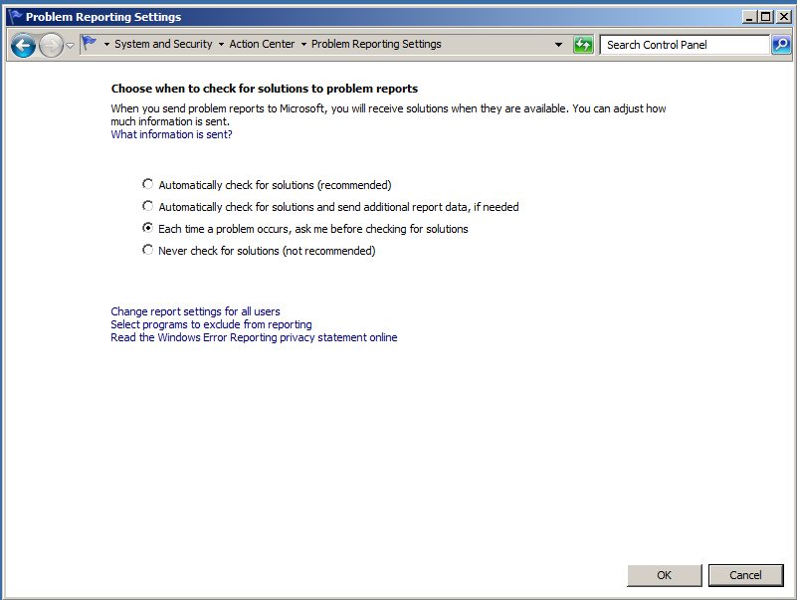
Windows Must Ask Before Checking For Solutions
In Control Panel navigate to this window and check ‘Each time a problem...’.

Slide 39
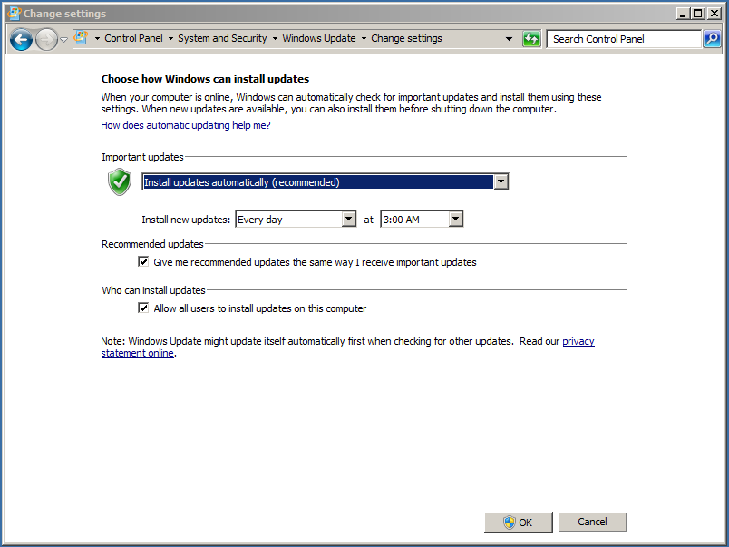
Get Recommended Updates
In Control Panel Navigate to this window and check the ‘Give me recommended...’.

Slide 40
Resources
http://lizardsystems.com/wiki/articles/configure_windows_firewall_using_command_line
https://technet.microsoft.com/en-us/library/dd734783(v=ws.10).aspx#BKMK_3_set
PowerPoint

